Slide 1

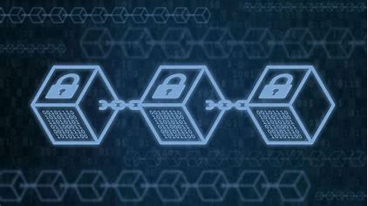
BLOCKCHAIN TECHNOLOGY
A PRESENTATION BY AMIT KUMAR PADHI
BRANCH-CST A
REGD.NO.-2201289334
ROLL NO.-06

Slide 2
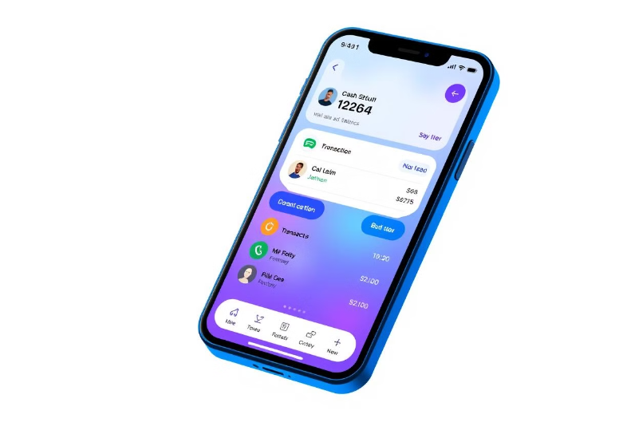
What is Blockchain? .A blockchain is a ledger that securely stores records, transactions and assets across a network. .It is a Decentralized network means there is no central authority to manage the network. It is transparent, immutable, and secure.
Applications include cryptocurrency, supply chain management, digital identity, and voting systems.

Slide 3
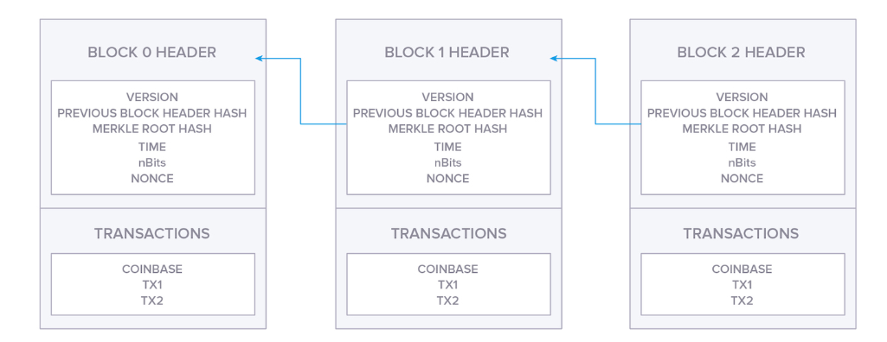
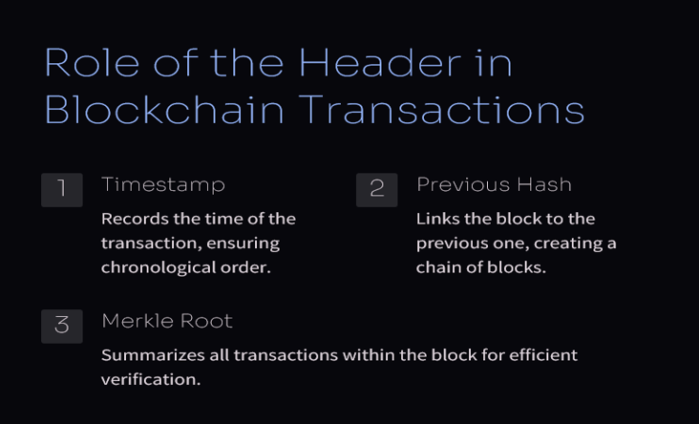
1

Slide 4
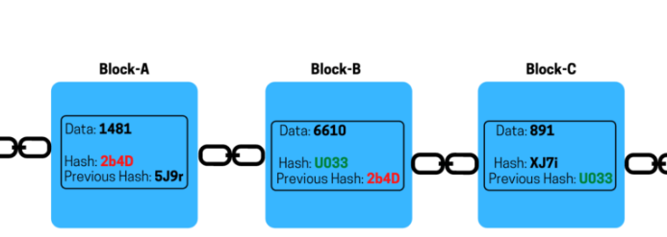
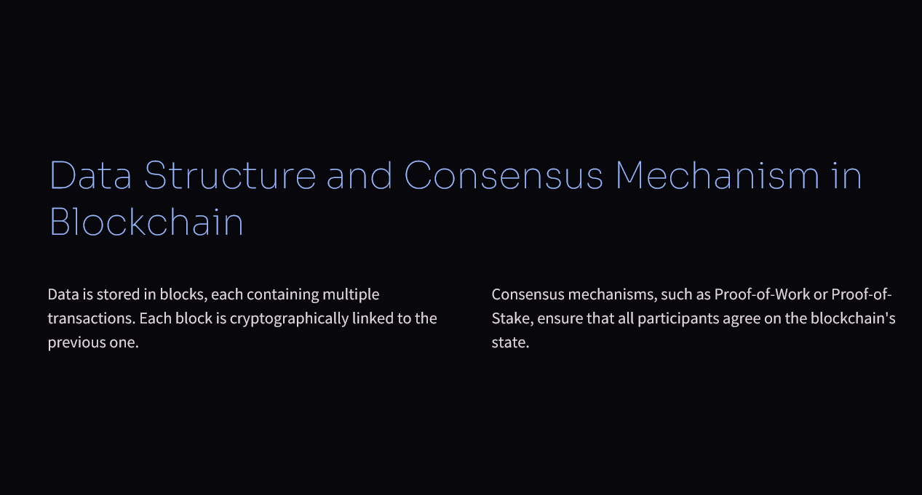

Slide 5
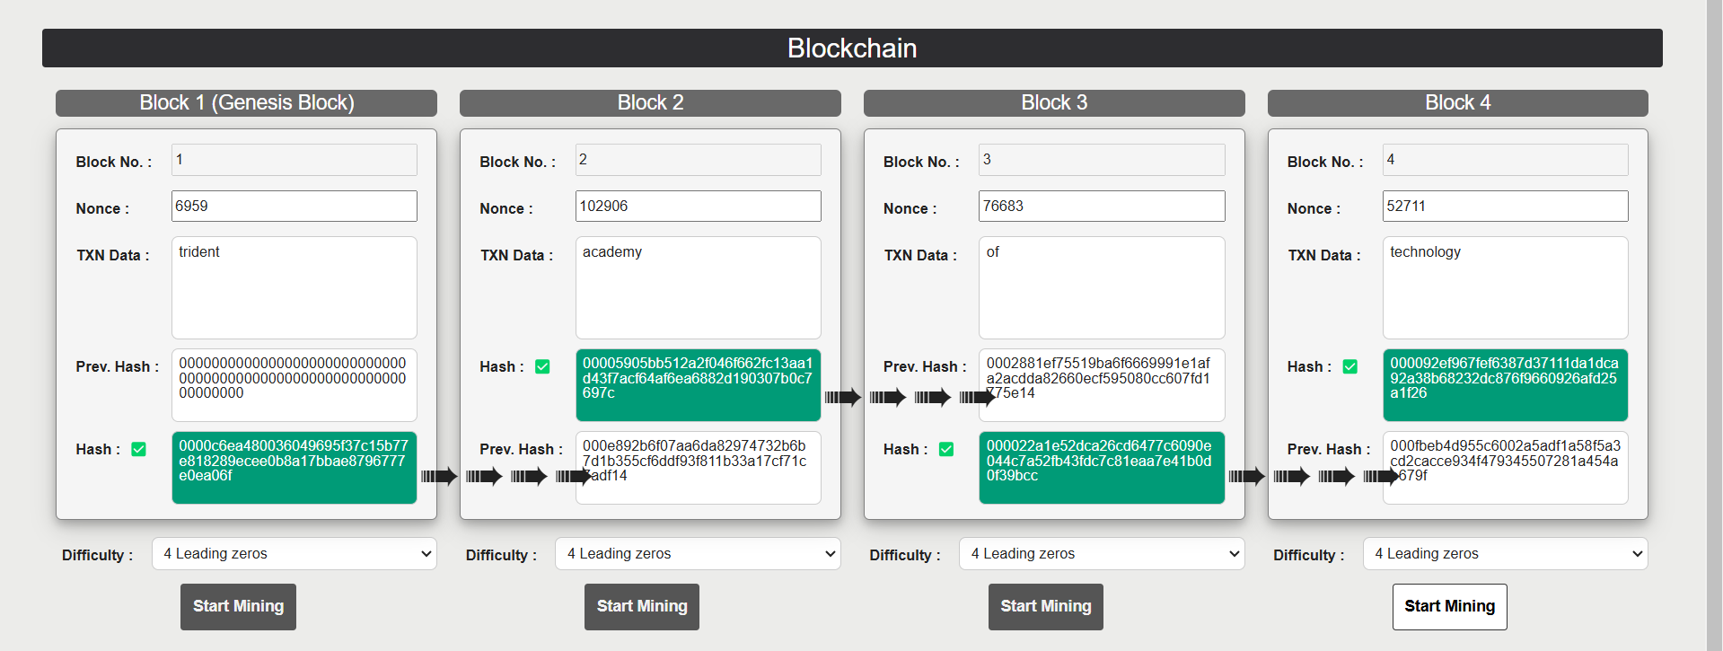
BLOCK CHAIN DEMO
BLOCKCHAIN

Slide 6
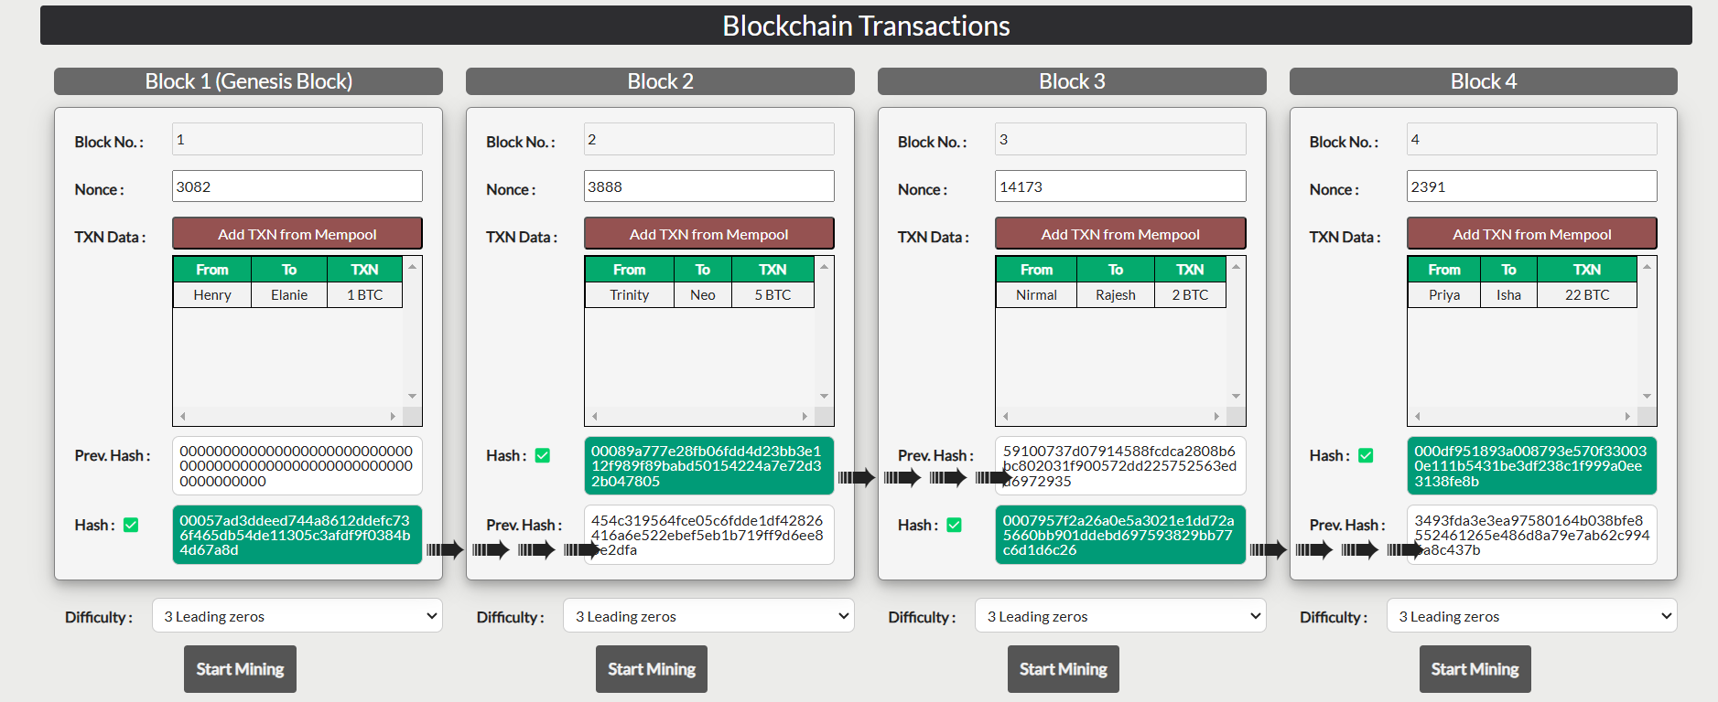
BLOCK CHAIN DEMO

Slide 7
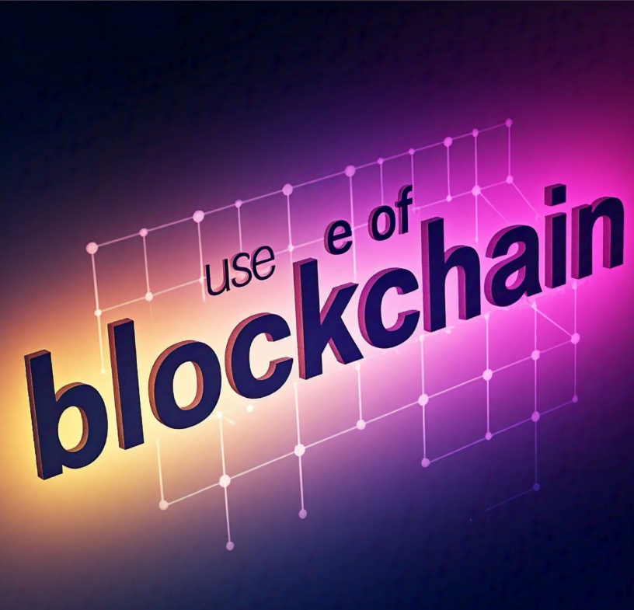

Slide 8
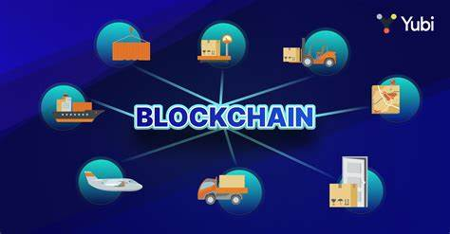
Cryptocurrency .Acts as the backbone for digital currencies like Bitcoin, Ethereum, and others. .Facilitates secure and transparent transactions without intermediaries (e.g., banks) Voting Systems .Ensures transparent and tamper-proof election processes. .Allows voters to verify their votes in real-time.
Education
Verifies academic credentials and certificates.
Prevents fraud in qualification claims.
Government Services
Streamlines record-keeping (e.g., land registries, licenses).
Reduces corruption by ensuring transparency in processes.

Slide 9
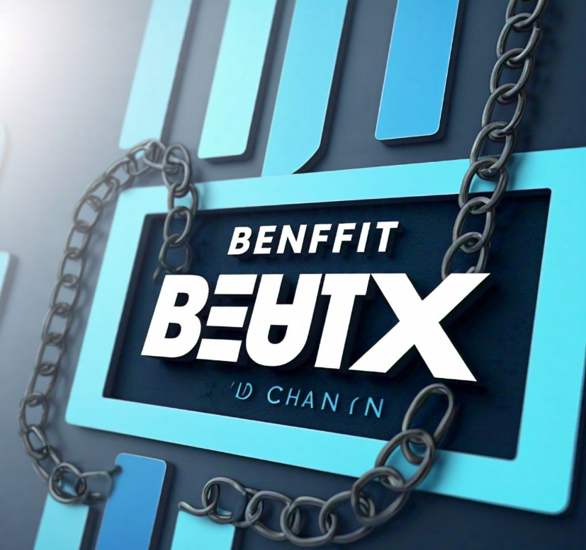

Slide 10
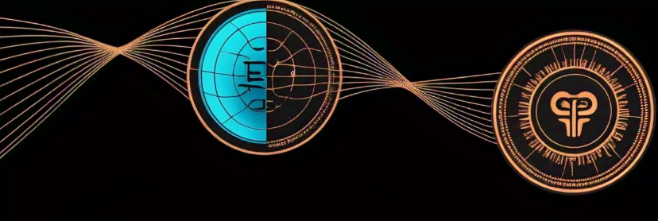
DECENTRALIZATION
Decentralization in blockchain refers to the system's structure where control and decision-making are distributed across a network of nodes (participants) rather than being managed by a central authority or a single entity.

Slide 11

TRANSPARENCY
Open and Accessible Data: Transparency in blockchain ensures that data stored on the blockchain is open and accessible to authorized participants.
Verifiable and Traceable Actions: All transactions and activities on the blockchain can be verified and traced by participants.
Fosters Trust: This transparency builds trust among users by allowing them to independently validate blockchain activities.

Slide 12

SECURITY
Robust Protection: Blockchain employs mechanisms and protocols to safeguard data, transactions, and the network from unauthorized access, tampering, and malicious activities.
Decentralized Architecture: Its distributed nature ensures no single point of failure, enhancing the network's resilience and security.
Cryptographic Techniques and Consensus: Blockchain utilizes advanced cryptography and consensus mechanisms to secure transactions and maintain data integrity.

Slide 13
